Slide 1
Presentation IoT4plant
24 Feb 2021

Slide 2
01 IoT4plant
02 LI prototype

Slide 3
IoT4plant objectives

Slide 4
Why ? Plant challanges
No data on critical equipment
Number of plants & equipments to inspect keep growing.
It required more and more hours
Rounds of inspection
taking a lot of time
Maintenance based on schedule not on real equipment data
Some equipment requires
temporary shut down to do the maintenance

Slide 5
What is IoT?
What is IoT4plant?
IoT = Internet of Things.
Network of dynamic interlinked components that sense context, transfer data, process information, and initiate action.
IoT4plant designed to help Plant manager to collect data on their equipment and create value with Analytics/Data Sciences.
No Wiring → Wireless Transmission, long battery life time
Low Cost Sensors → Sensor Provider Ecosystem
Low Cost Communication (IoT Networks)

Slide 6


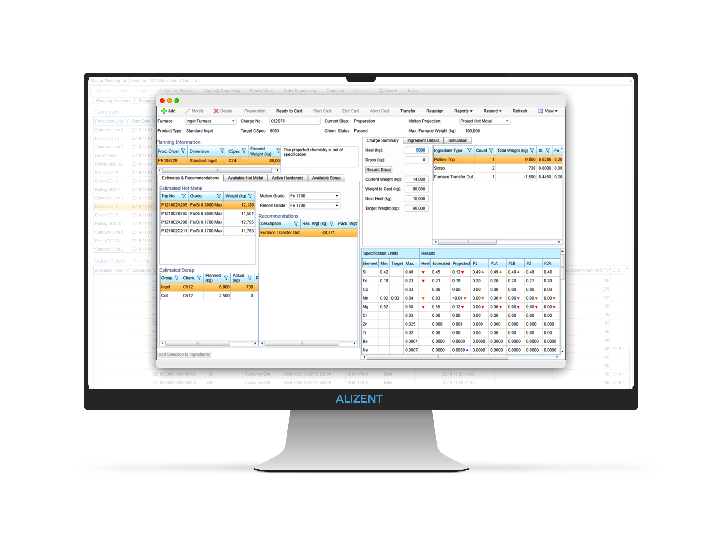


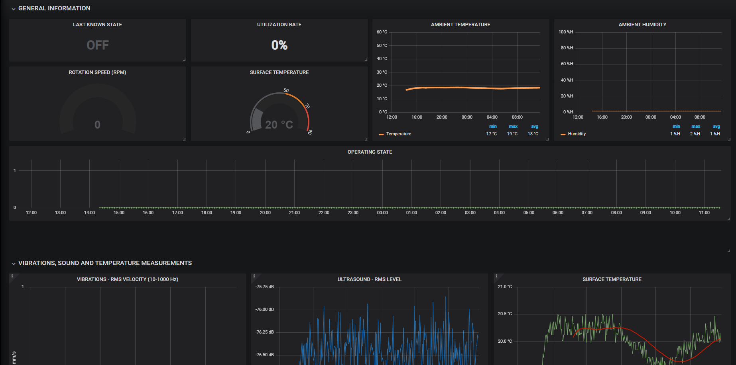


How IoT4plant works?
Sensor placed on the equipment
Gateway
Data send to cloud
1
2
LoRa
Gateway
System
IoT Devices,
Sensors & Actuators
IIoT4Plant
Web Portal

Slide 7
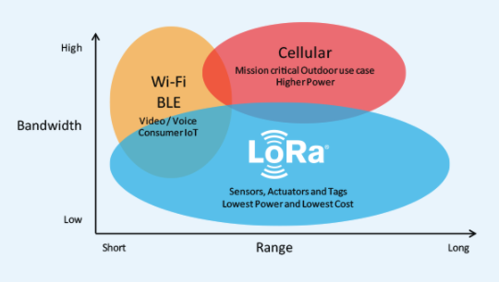
LoRaWAN Network
LoRaWAN network:
up to 20 km range
Low power:
Penetrate physical structures
Long battery life

Slide 8
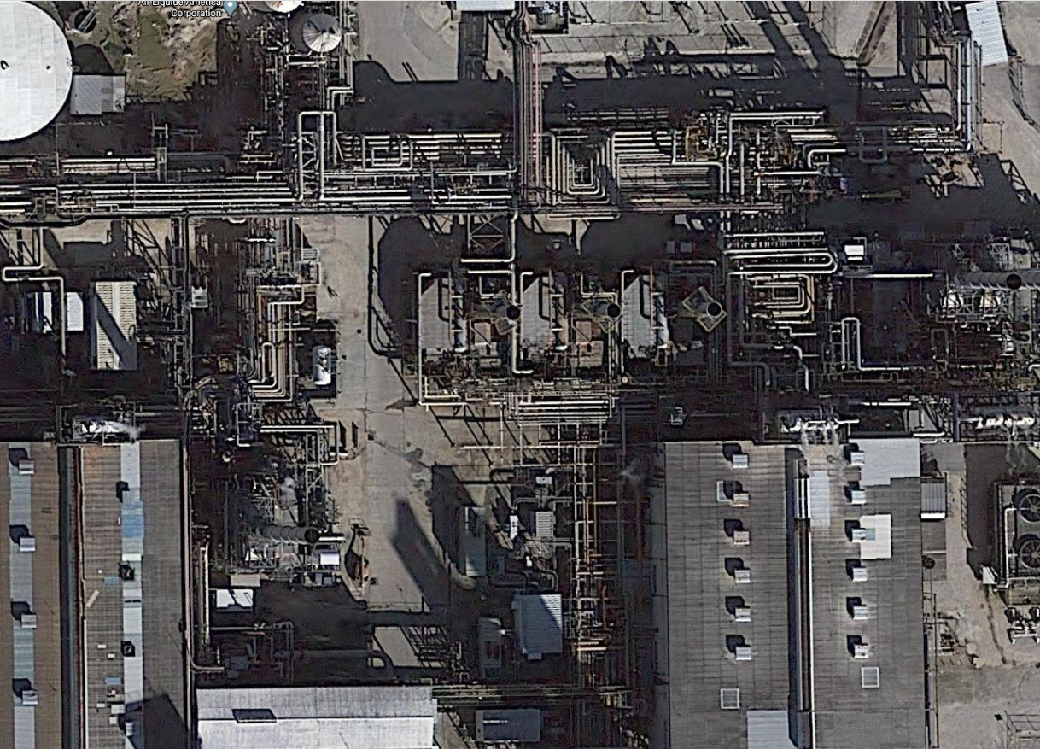

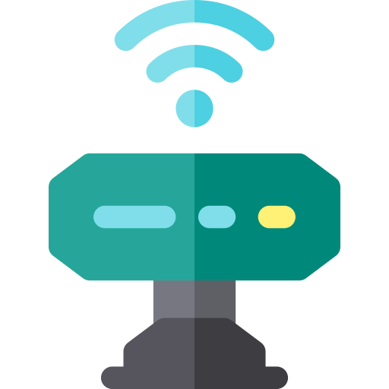
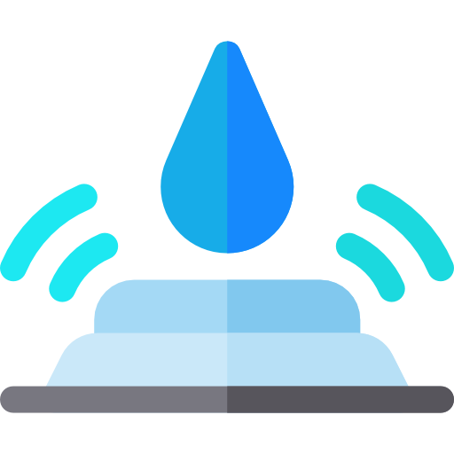







Differents sensors for differents needs?
Vibration
All sensors are communicating with an unique Gateway that can be placed on the roof of the control room
IIoT4Plant Solution
Leakage
Humidity
Pressure
Joint Alert
Valve Positioning
Temperature
Gateway
OIL & GAS
FACILITY
Motion Movement

Slide 9
IoT4plant LI - Prototype

Slide 10

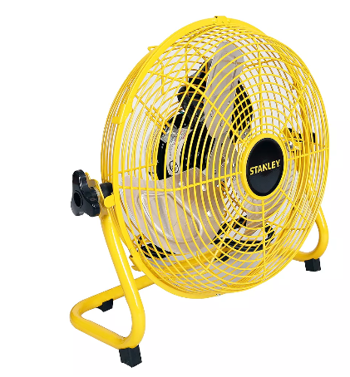


IoT4plant LI - Prototype
The objectives of this “prototype” are to demonstrate:
Data can collected directly from the sensors through an IoT network (typical situation, variation of vibration ..)
IoT Data can be transferred into PI, and seen as any other tags in the PI
Alizent
EH
LoRa Gateway
+
LoRa Network Server
Rest API
App server
Phase 1: Test in Alizent Office
AL network validation, GIO approval
Phase 2: Test in ASU

Slide 11

Team
Alain Lecours
Guillaume Soyer
Installation & training hardware
PI Connection

Slide 12
Asystom
The AsystomSentinel beacon is multi sensor device (sound, vibration, ultrasound, shock, ambient and contact, temperature, ambient humidity).
It incorporates different sensor that gather at the same times data.
It is non-intrusive and is glued on the equipment.
AsystomSentinel is an “intelligence at the edge” device with an embedded, powerful, real-time
microprocessor to manage the built-in sensors, calculating a machine signature before sending the
results through the LoRa network.
The Multi-Sensor Device has a machine learning capability which establishes the machine’s normal
behaviour. Then it collects, analyses equipment operating data and transmits the results through a
secure LoRa (Long Range) wireless network. Configuration is managed remotely.

Slide 13
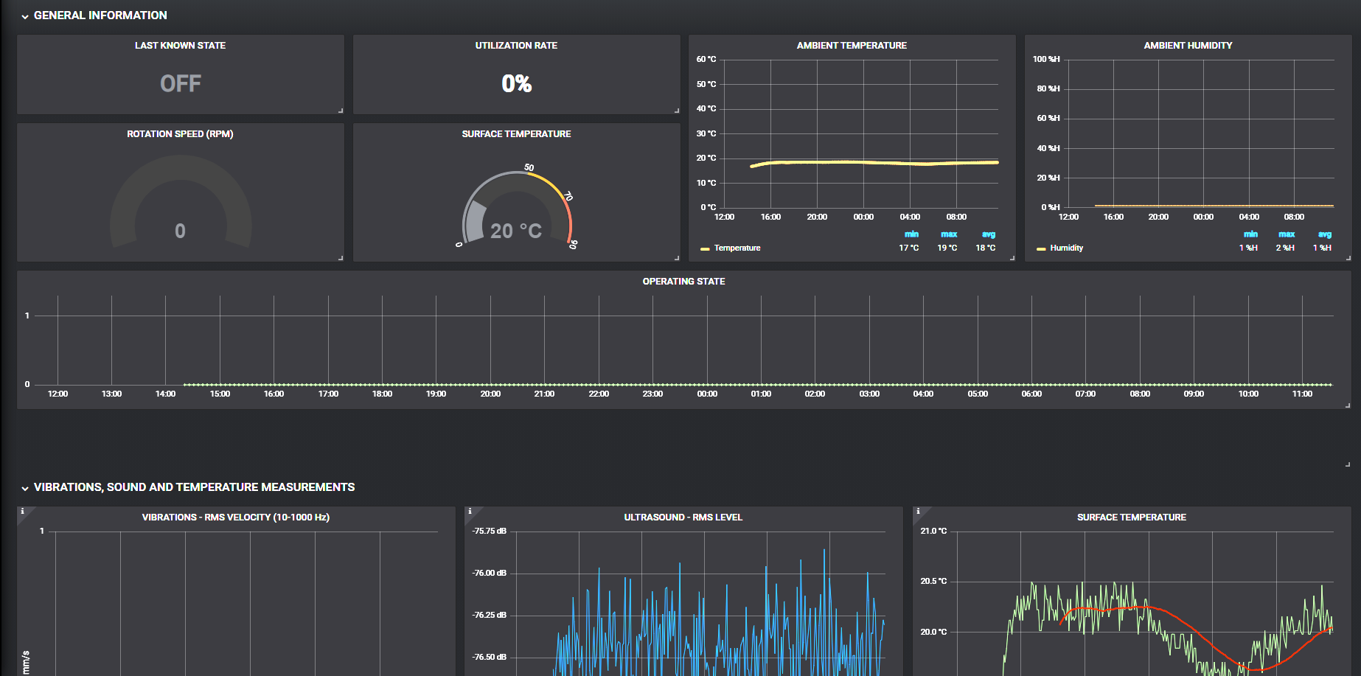
IoT4plant LI - Prototype
Dashboard

